Slide 1
A Small Palette for a Large Canvas: Coloring the Plane
Jeffrey Kane
McDaniel College
Amateur Professional Coloring Artist

Slide 2

Chromatic Number of a Graph
The chromatic number of a graph is the smallest number of “colors” so no adjacent vertices have the same “color.”
We denote the chromatic number of a graph G by .

Slide 3










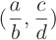

Chromatic Number of
Let G be a graph with vertices and edges if
Consider a point distance 1 from the origin, where
Define a relation such that iff and have odd denominators.
It suffices to color one class.
Color the point green if is even and gold if it is odd.

Slide 4



Hadwiger-Nelson Problem
Let G be a graph with vertices and edges if
What is
For shorthand, we simply write when dealing with this graph.

Slide 5

Coloring
We can color the plane with nine colors.
We cannot color the plane with less than four colors.

Slide 6
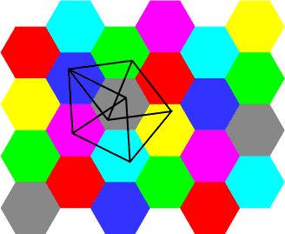
Coloring better
Hexagons
Squares
Source: http://www.ics.uci.edu/~eppstein/junkyard/open.html

Slide 7

Frustration
We’ve had these bounds for over 50 years.
Life motto: When your problem is too hard, change your problem.
New problem: Find the polychromatic number, denoted .

Slide 8
Trying to Color
Guess: We can color with three colors now!
Let’s suppose that we can, and see how it goes from there.

Slide 9

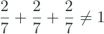


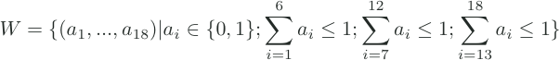




are three Mosers’ Spindles with lengths respectively, all sharing .
Defines 18 vectors.
The color of is the color of .

Slide 10
Coloring better
Hexagons and triangles
Large square, small square construction

Slide 11




Theorem
For every there is a 6-coloring of the plane with type

Slide 12
de Brujin-Erdős Theorem
For any graph G and integer k, G can be colored by k colors iff all finite subgraphs can be colored by k colors.
Assumes the Axiom of Choice.

Slide 13










Axiom of Choice
Let G be a graph with vertices and edges if
.
Let .
iff .
Pick representatives for each class .
iff .

Slide 14
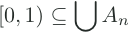





Without the Axiom of Choice
Let G be a graph with vertices and edges if
.
If and contains no connected points, then it has Lebesgue measure
Then, as Lebesgue measure is additive, if are sets such that then some set has two connected points.

Slide 15
Questions, Concerns, Consternations?

